Slide 1
Capstone Project 1 Weekly Meeting
Notes:
Most of what I am talking about is covered in the guidelines for use, found at the front of the RDA.

Slide 2
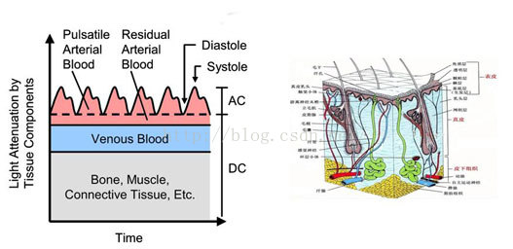
PPG Signal
Notes:
The purpose of the RDA is to provide a legal mechanism for the retention & disposal of university records in accordance with legislative instruments and regulations issued under the Public Records Act 1973.
The Authority also -
identifies records which are required to be preserved permanently as part of the University’s archival heritage;
prevents the premature destruction of records which need to be retained for a specified period to satisfy legal, financial and other requirements of public administration;
specifies the minimum, and in some cases maximum, periods for which records are required to be retained;
authorises the destruction of those records not required permanently; and
mandates the prompt destruction of records as required under the Information Privacy Act 2000 and other instruments

Slide 3
Heart Rate Detection
Using the green LED, we obtained the heart rate raw data and its curve.
Raw data in time domain
Raw data in frequency domain
Notes:
The purpose of the RDA is to provide a legal mechanism for the retention & disposal of university records in accordance with legislative instruments and regulations issued under the Public Records Act 1973.
The Authority also -
identifies records which are required to be preserved permanently as part of the University’s archival heritage;
prevents the premature destruction of records which need to be retained for a specified period to satisfy legal, financial and other requirements of public administration;
specifies the minimum, and in some cases maximum, periods for which records are required to be retained;
authorises the destruction of those records not required permanently; and
mandates the prompt destruction of records as required under the Information Privacy Act 2000 and other instruments

Slide 4
Possible Noise of the Signal
Power frequency interference, can be ignore since AAA battery(DC) will be used.
Interference from external light sources, use band-pass filter since HR is in certain frequency range.
Body movement like breathing will cause baseline drift, can use i.e. high-pass filter, median filtering or wavelet transformation.
Notes:
The University of Melbourne Records Retention and Disposal Authority (RDA) is
“…the University document that sets out requirements for retention and disposal of all types of records, in line with legislative requirements and University business needs…”
(Records Management Policy MPF1106)
Records Services is responsible for developing the RDA
The University Archivist, Legal Services and the Director, Internal Audit are also consulted
The final document is approved by the University Secretary
(Records Management Policy MPF 1106, Records Retention and Disposal Procedure MPF1109)

Slide 5
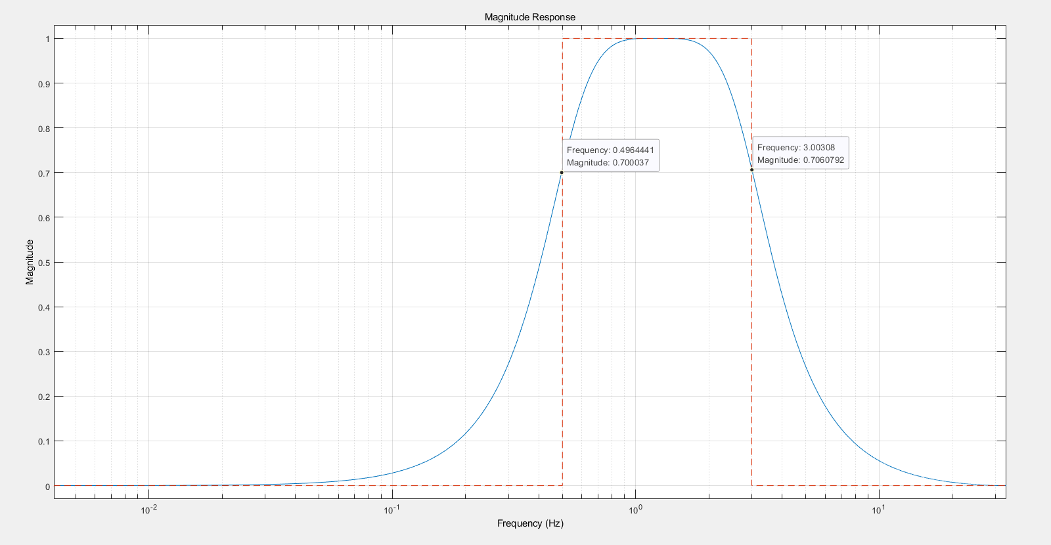
IIR Filter
Due to that the heart rate has a certain frequency range, a band-pass filter with a passband from 0.5 Hz to 3Hz to allow the heart- beat signal to come through and the rest of the signal noise to be rejected. Here, a 4-order Butterworth bandpass filter is chosen.
Notes:
The University of Melbourne Records Retention and Disposal Authority (RDA) is
“…the University document that sets out requirements for retention and disposal of all types of records, in line with legislative requirements and University business needs…”
(Records Management Policy MPF1106)
Records Services is responsible for developing the RDA
The University Archivist, Legal Services and the Director, Internal Audit are also consulted
The final document is approved by the University Secretary
(Records Management Policy MPF 1106, Records Retention and Disposal Procedure MPF1109)

Slide 6
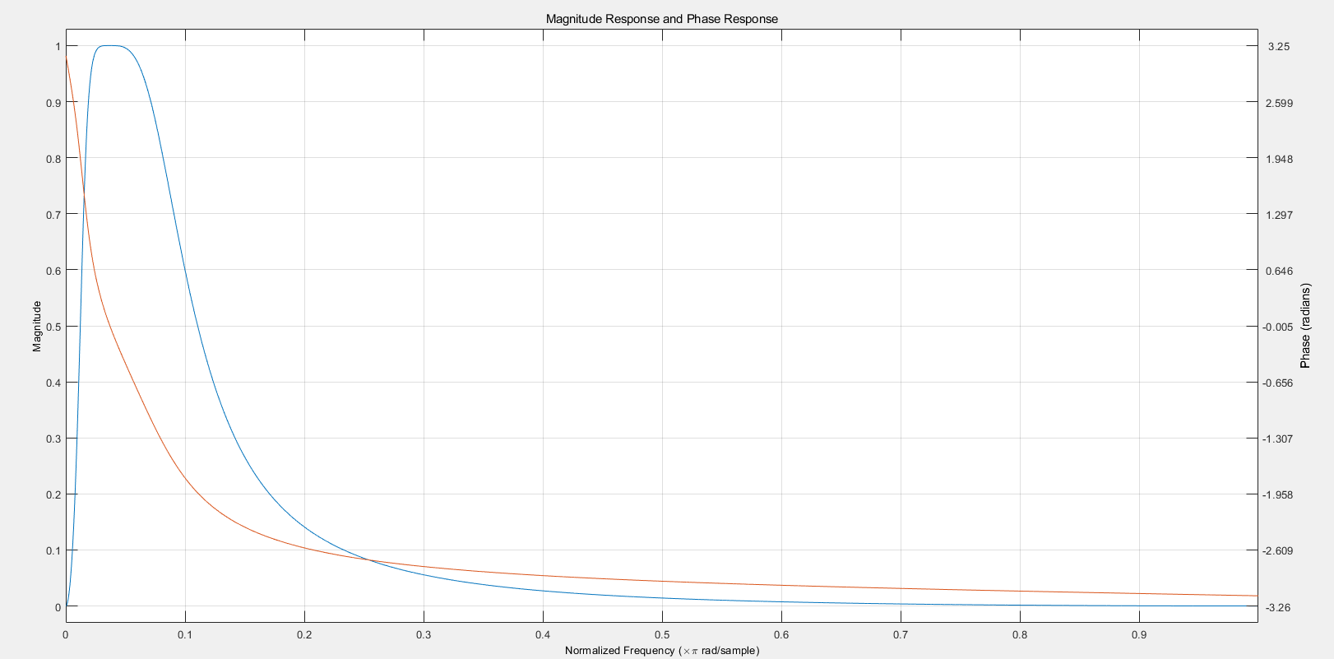
IIR Filter
Since the phase is nonlinear, we need to use FIR filter to obtain a fixed group delay.

Slide 7
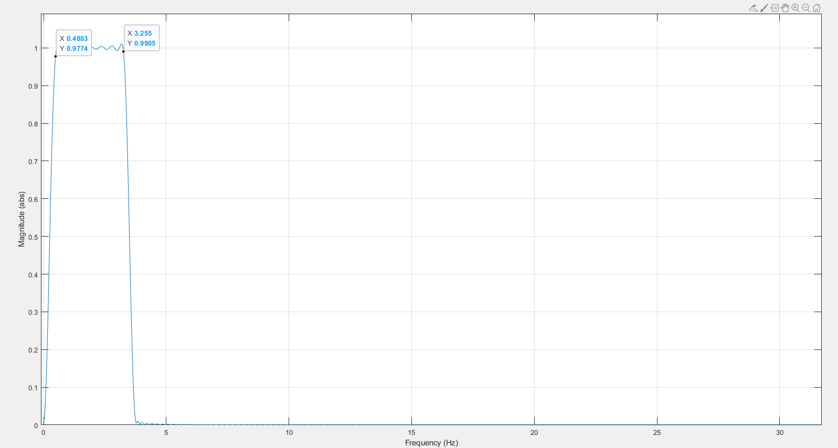
FIR Filter1 (Kaiser Window)
Notes:
What records does the RDA apply to?
The RDA applies to University records only. A University record is defined as “…any record comprised of recorded information, in any format, created or received by staff of the University in the course of conducting their University duties…”
(Records Management Policy MPF1106)

Slide 8
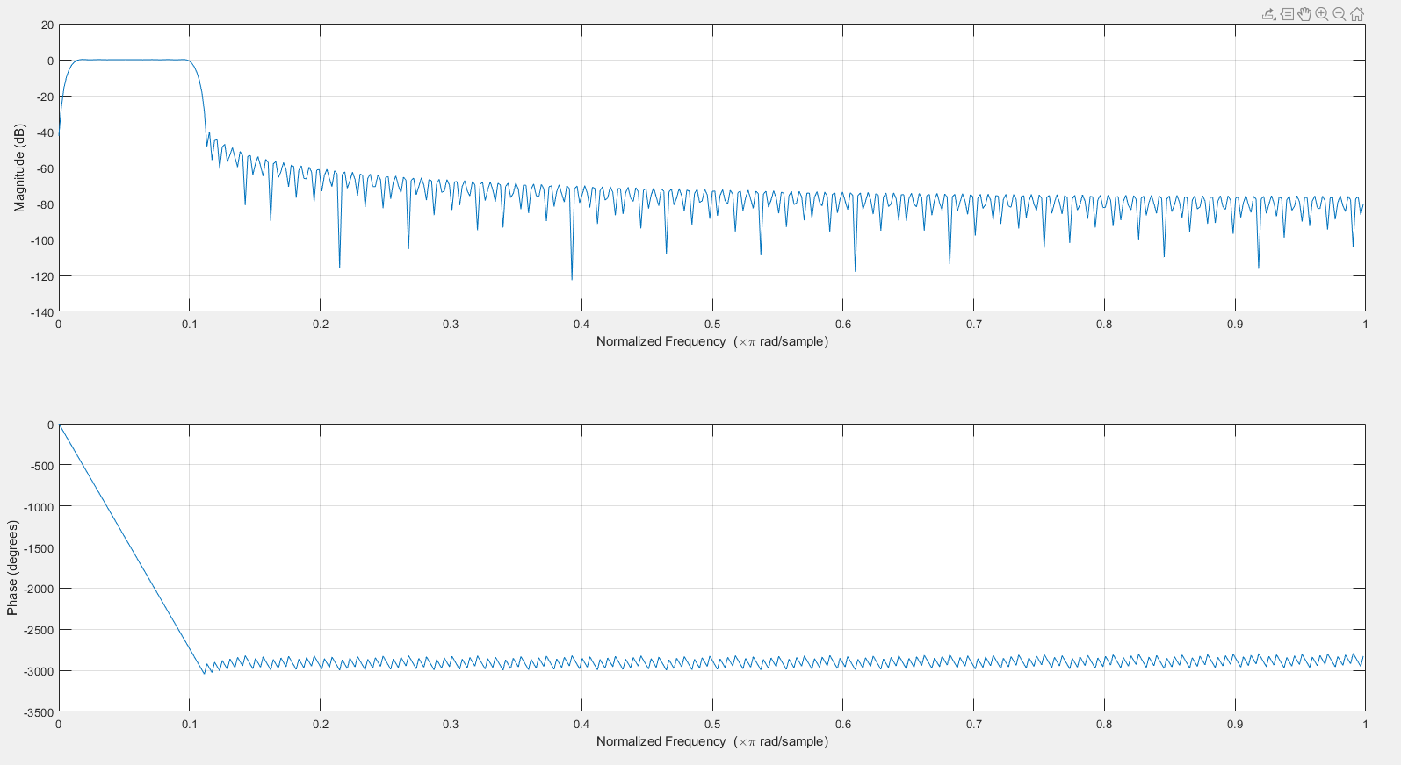
FIR Filter1 (Kaiser Window)
Notes:
What records does the RDA apply to?
The RDA applies to University records only. A University record is defined as “…any record comprised of recorded information, in any format, created or received by staff of the University in the course of conducting their University duties…”
(Records Management Policy MPF1106)

Slide 9
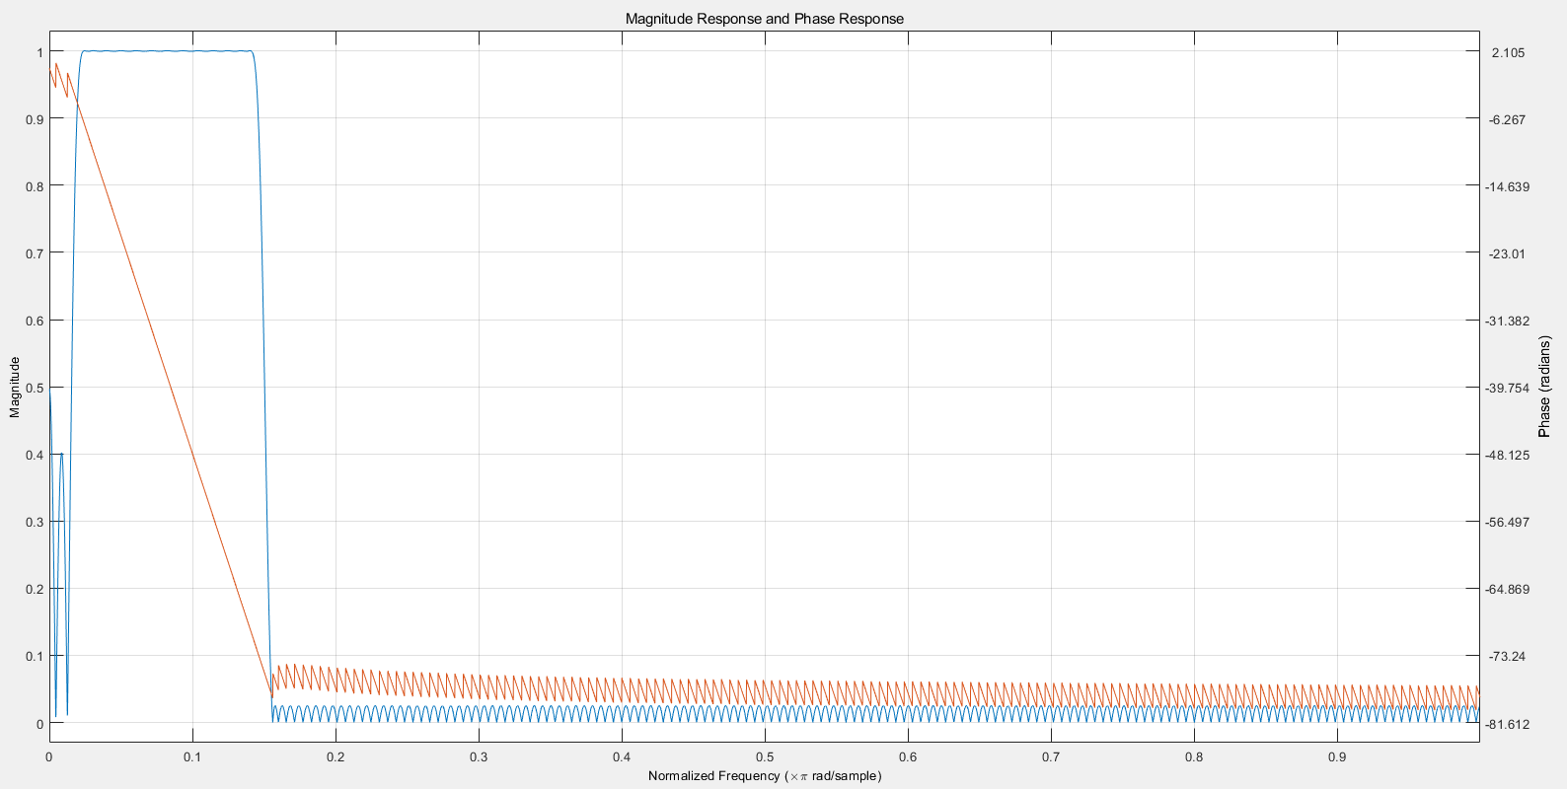
FIR Filter2 (Digital Filter)
Notes:
What records does the RDA apply to?
The RDA applies to University records only. A University record is defined as “…any record comprised of recorded information, in any format, created or received by staff of the University in the course of conducting their University duties…”
(Records Management Policy MPF1106)

Slide 10
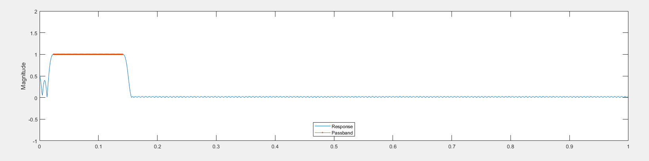
FIR Filter2 (Digital Filter)
Notes:
What records does the RDA apply to?
The RDA applies to University records only. A University record is defined as “…any record comprised of recorded information, in any format, created or received by staff of the University in the course of conducting their University duties…”
(Records Management Policy MPF1106)

Slide 11
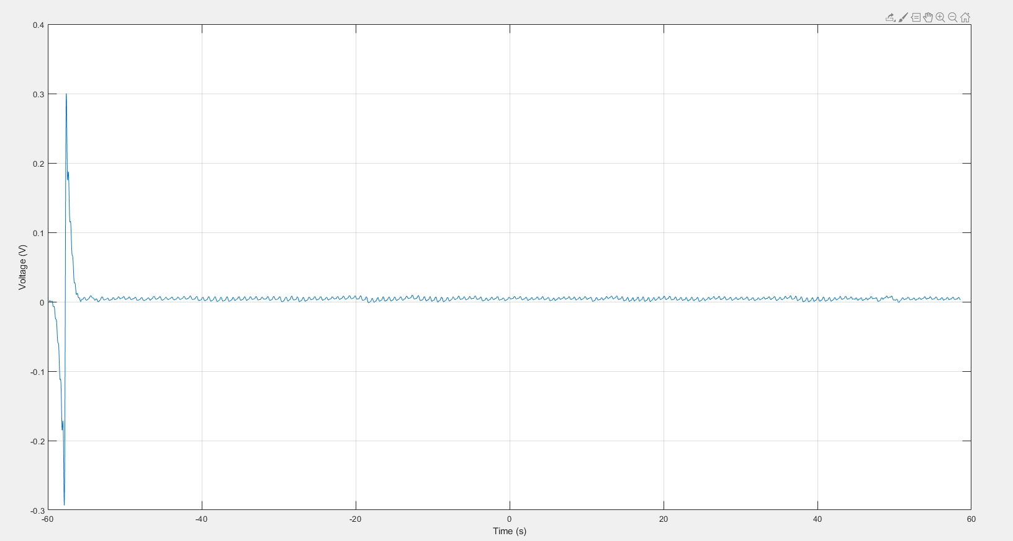
PPG Signal after Filter1
Notes:
What records does the RDA apply to?
The RDA applies to University records only. A University record is defined as “…any record comprised of recorded information, in any format, created or received by staff of the University in the course of conducting their University duties…”
(Records Management Policy MPF1106)

Slide 12
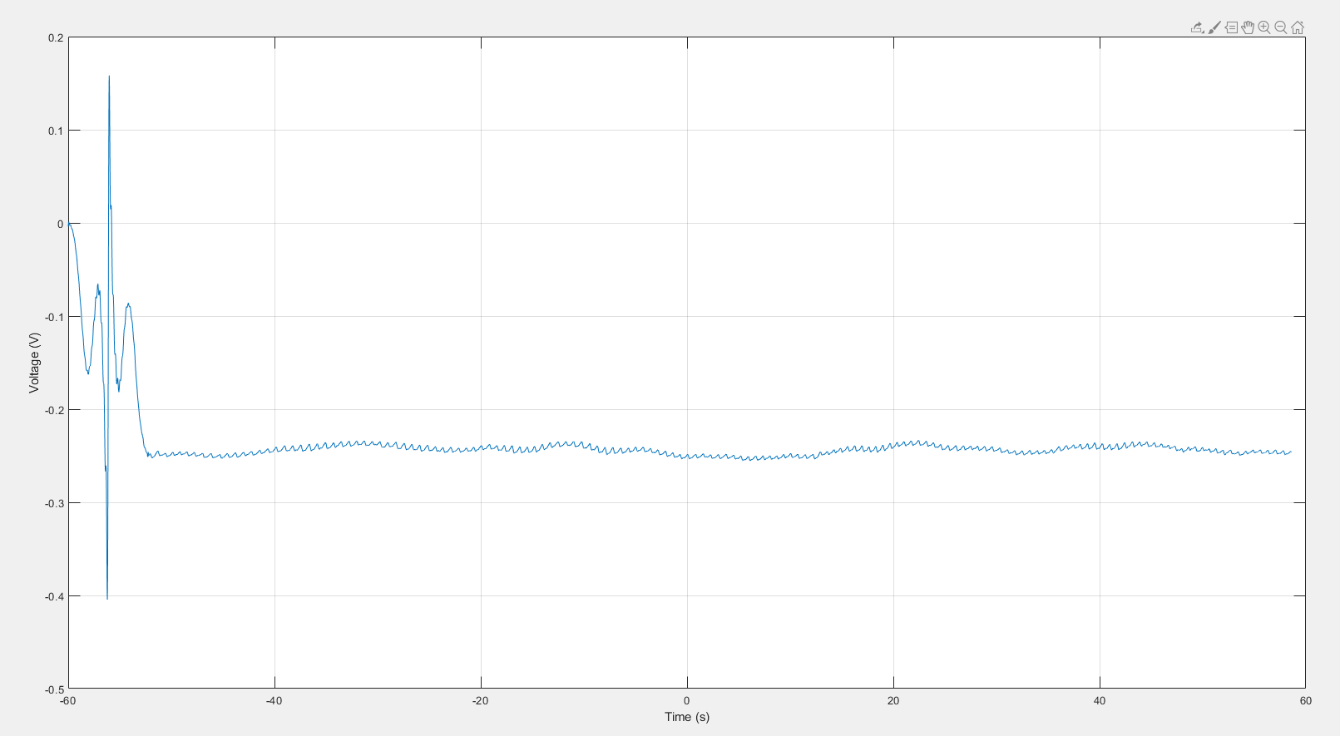
PPG Signal after Filter2
Notes:
What records does the RDA apply to?
The RDA applies to University records only. A University record is defined as “…any record comprised of recorded information, in any format, created or received by staff of the University in the course of conducting their University duties…”
(Records Management Policy MPF1106)

Slide 13
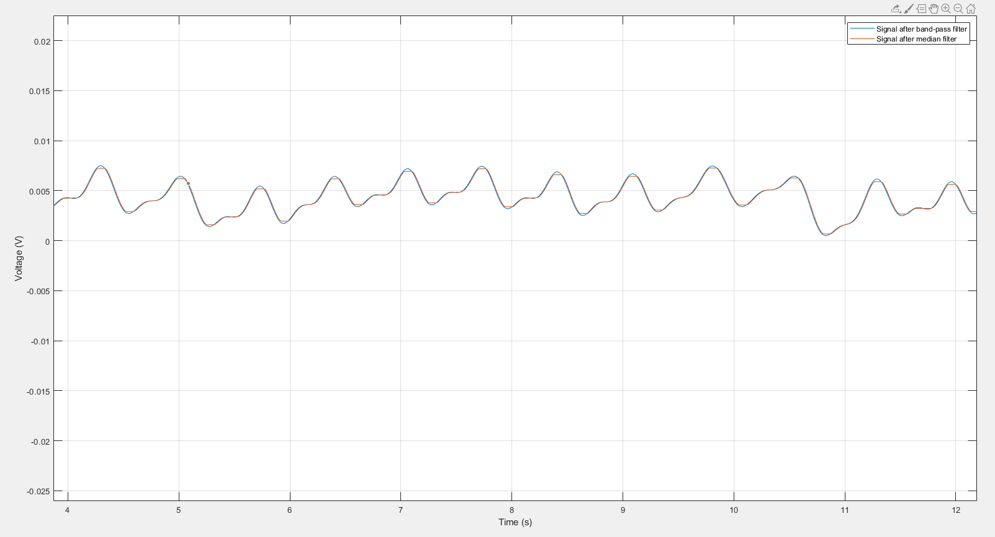
Median Filter on PPG Signal after Filter1
Notes:
What records does the RDA apply to?
The RDA applies to University records only. A University record is defined as “…any record comprised of recorded information, in any format, created or received by staff of the University in the course of conducting their University duties…”
(Records Management Policy MPF1106)

Slide 14
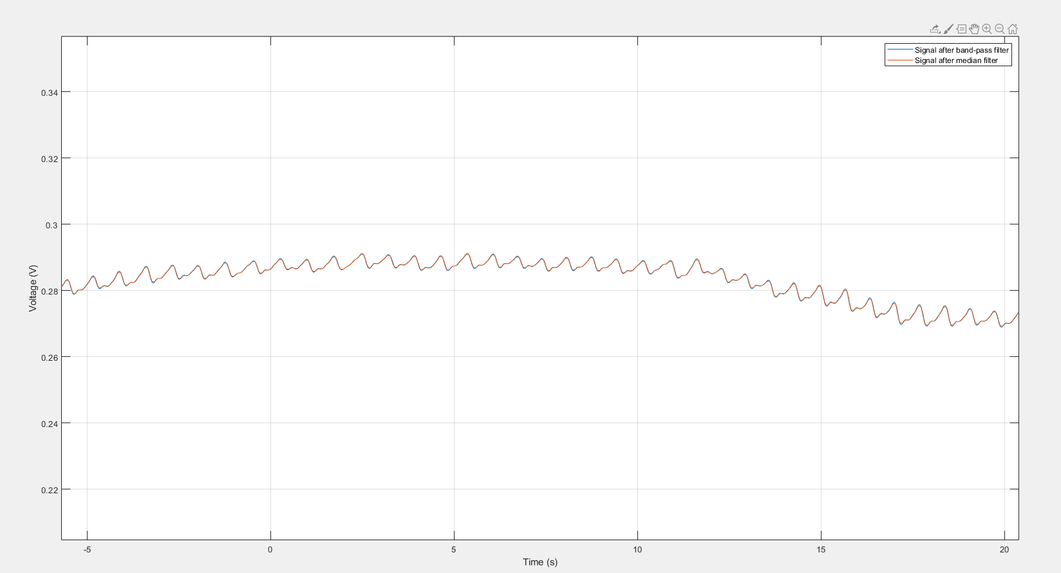
Median Filter on PPG Signal after Filter2
Notes:
What records does the RDA apply to?
The RDA applies to University records only. A University record is defined as “…any record comprised of recorded information, in any format, created or received by staff of the University in the course of conducting their University duties…”
(Records Management Policy MPF1106)

Slide 15
Ellipord Filter
From figures above, the performance is not ideal in solving the baseline drift problem. Thus, a new method is applied here.
Notes:
What records does the RDA apply to?
The RDA applies to University records only. A University record is defined as “…any record comprised of recorded information, in any format, created or received by staff of the University in the course of conducting their University duties…”
(Records Management Policy MPF1106)

Slide 16
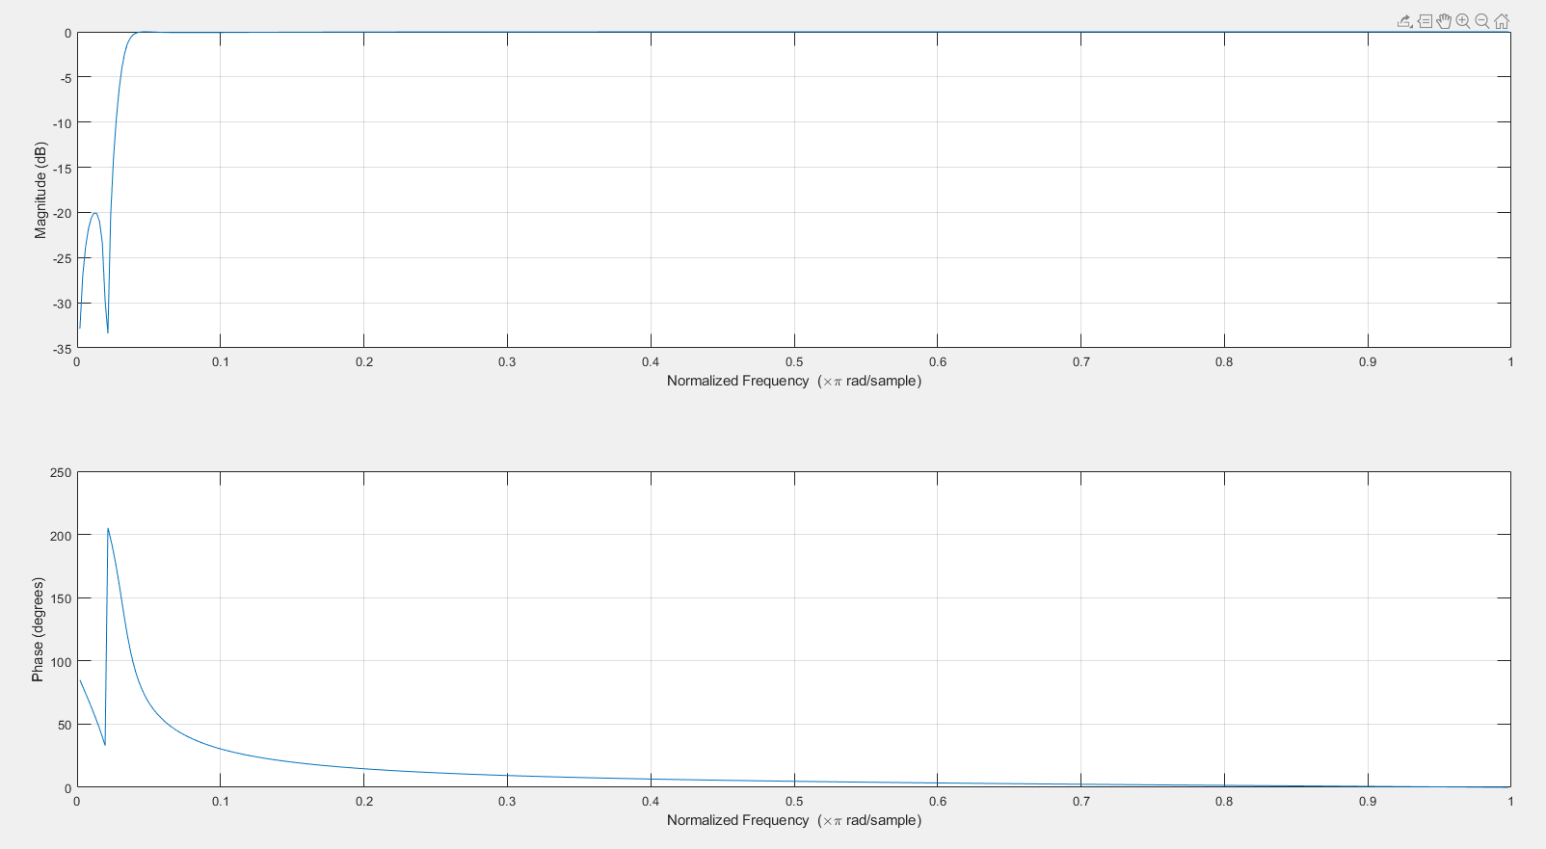
Ellipord Filter (Zero Phase Shift)
Notes:
What records does the RDA apply to?
The RDA applies to University records only. A University record is defined as “…any record comprised of recorded information, in any format, created or received by staff of the University in the course of conducting their University duties…”
(Records Management Policy MPF1106)

Slide 17
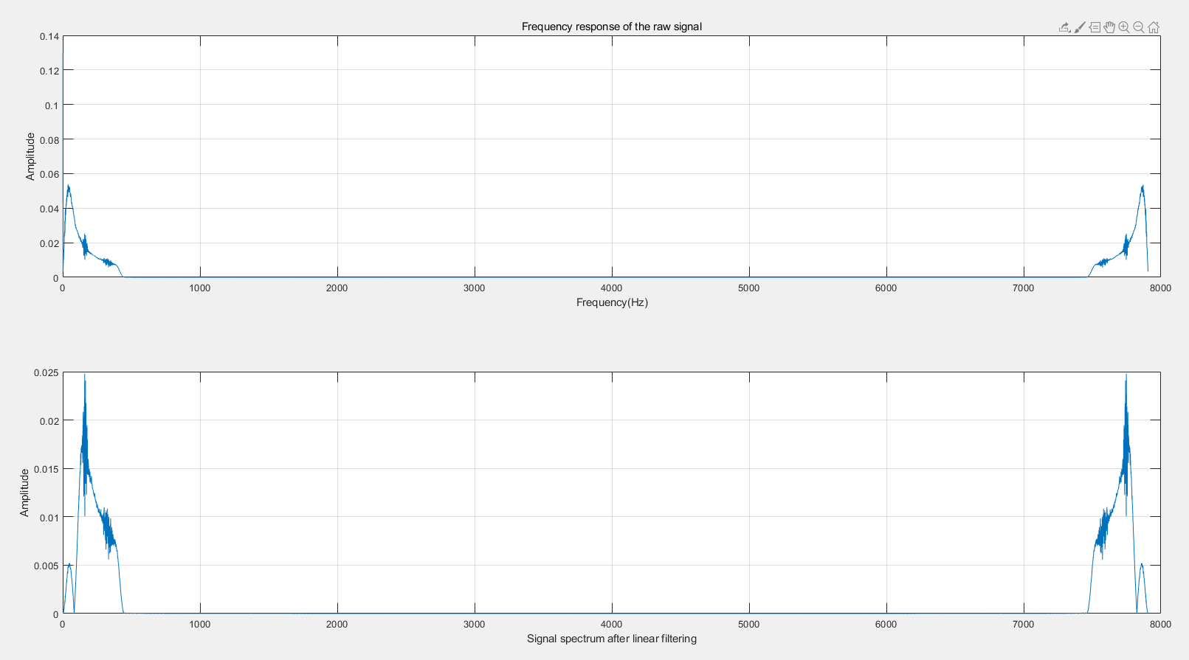
Ellipord Filter (Filter1)
Notes:
What records does the RDA apply to?
The RDA applies to University records only. A University record is defined as “…any record comprised of recorded information, in any format, created or received by staff of the University in the course of conducting their University duties…”
(Records Management Policy MPF1106)

Slide 18
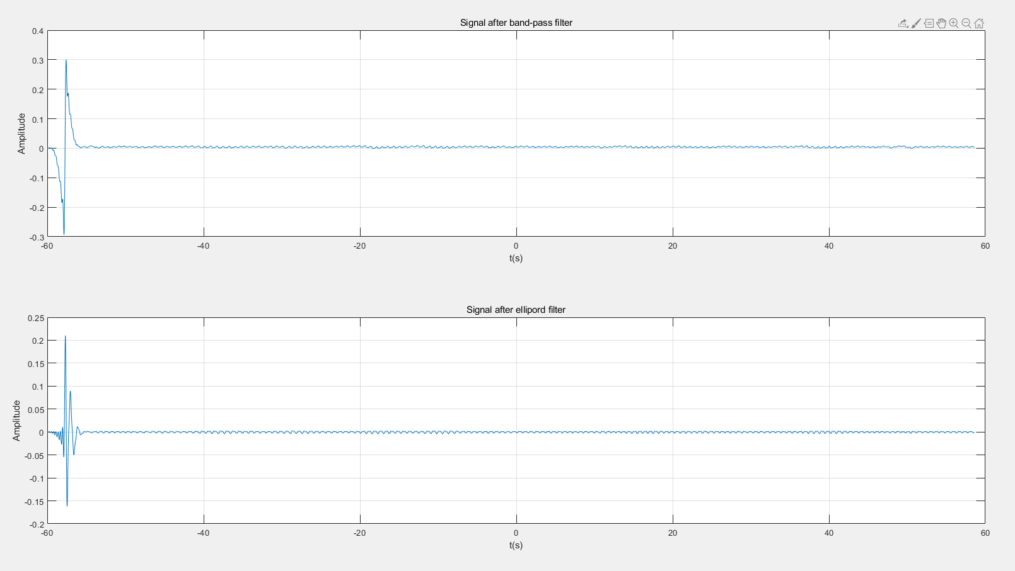
Ellipord Filter (Filter1)
Notes:
What records does the RDA apply to?
The RDA applies to University records only. A University record is defined as “…any record comprised of recorded information, in any format, created or received by staff of the University in the course of conducting their University duties…”
(Records Management Policy MPF1106)

Slide 19
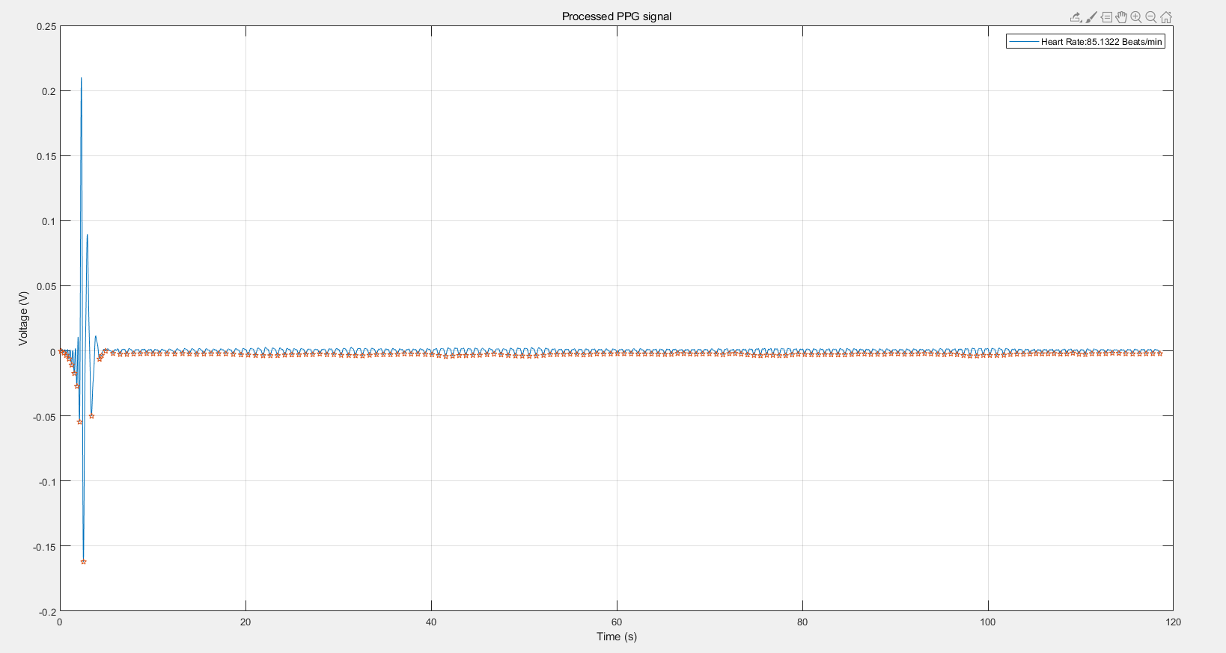

Heart Rate Detection (Filter1)
Notes:
So what about records of semi-autonomous bodies or subsidiary companies?
Records of University business operations (or semi-autonomous bodies – these are listed in the Annual Report & include the Melbourne Theatre Company, Asialink, Melbourne University Sport etc) are University records.
Records of University subsidiaries, i.e. University controlled entities (listed in the Annual Report & include Melbourne University Publishing, Melbourne University Student Union etc), are not University records & the RDA does not apply. Subsidiaries are responsible for managing their own records in accordance with any relevant legislation.
However, all records created by or provided by the University in connection with its dealings with semi-autonomous bodies and subsidiaries are University records.

Slide 20
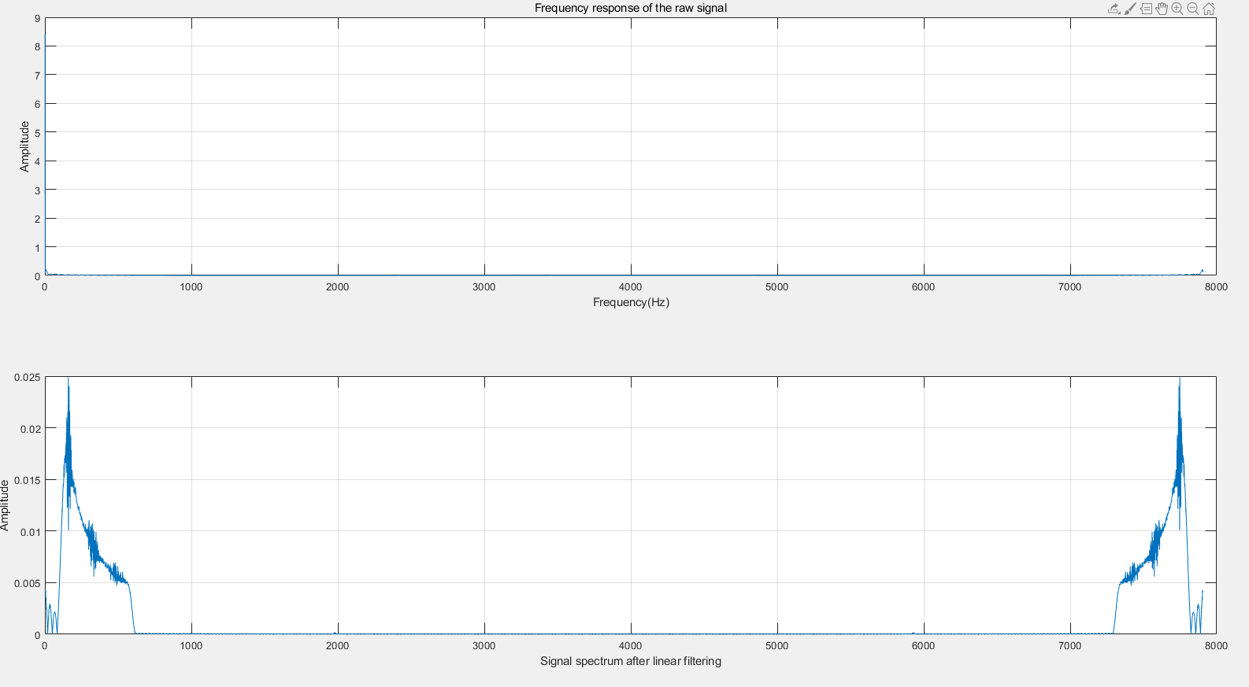
Ellipord Filter (Filter2)
Notes:
So what about records of semi-autonomous bodies or subsidiary companies?
Records of University business operations (or semi-autonomous bodies – these are listed in the Annual Report & include the Melbourne Theatre Company, Asialink, Melbourne University Sport etc) are University records.
Records of University subsidiaries, i.e. University controlled entities (listed in the Annual Report & include Melbourne University Publishing, Melbourne University Student Union etc), are not University records & the RDA does not apply. Subsidiaries are responsible for managing their own records in accordance with any relevant legislation.
However, all records created by or provided by the University in connection with its dealings with semi-autonomous bodies and subsidiaries are University records.

Slide 21
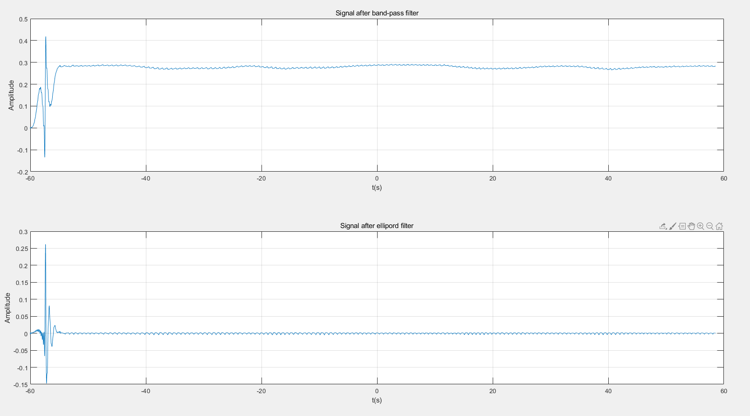
Ellipord Filter (Filter2)
Notes:
So what about records of semi-autonomous bodies or subsidiary companies?
Records of University business operations (or semi-autonomous bodies – these are listed in the Annual Report & include the Melbourne Theatre Company, Asialink, Melbourne University Sport etc) are University records.
Records of University subsidiaries, i.e. University controlled entities (listed in the Annual Report & include Melbourne University Publishing, Melbourne University Student Union etc), are not University records & the RDA does not apply. Subsidiaries are responsible for managing their own records in accordance with any relevant legislation.
However, all records created by or provided by the University in connection with its dealings with semi-autonomous bodies and subsidiaries are University records.

Slide 22
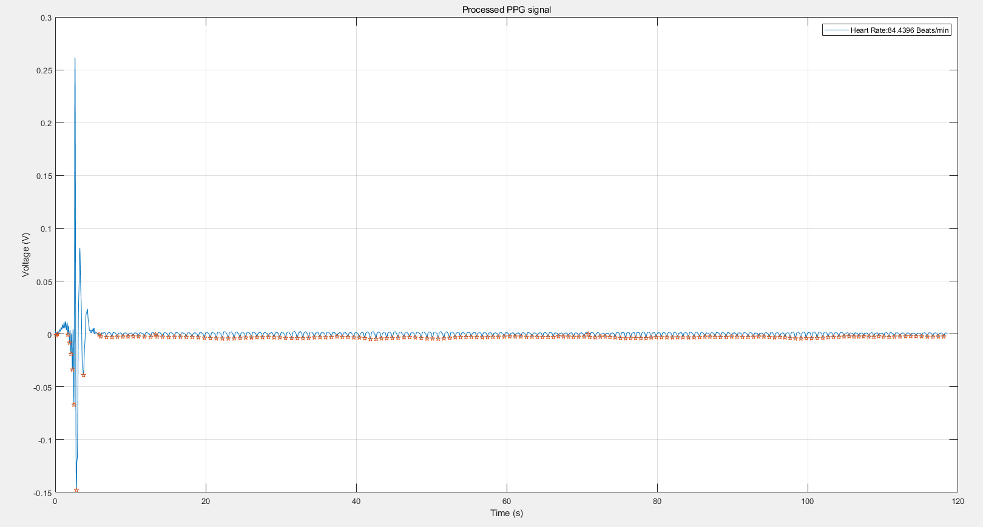
Heart Rate Detection (Filter3)
Notes:
So what about records of semi-autonomous bodies or subsidiary companies?
Records of University business operations (or semi-autonomous bodies – these are listed in the Annual Report & include the Melbourne Theatre Company, Asialink, Melbourne University Sport etc) are University records.
Records of University subsidiaries, i.e. University controlled entities (listed in the Annual Report & include Melbourne University Publishing, Melbourne University Student Union etc), are not University records & the RDA does not apply. Subsidiaries are responsible for managing their own records in accordance with any relevant legislation.
However, all records created by or provided by the University in connection with its dealings with semi-autonomous bodies and subsidiaries are University records.

Slide 23

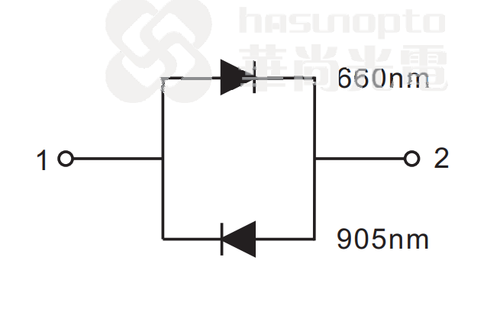
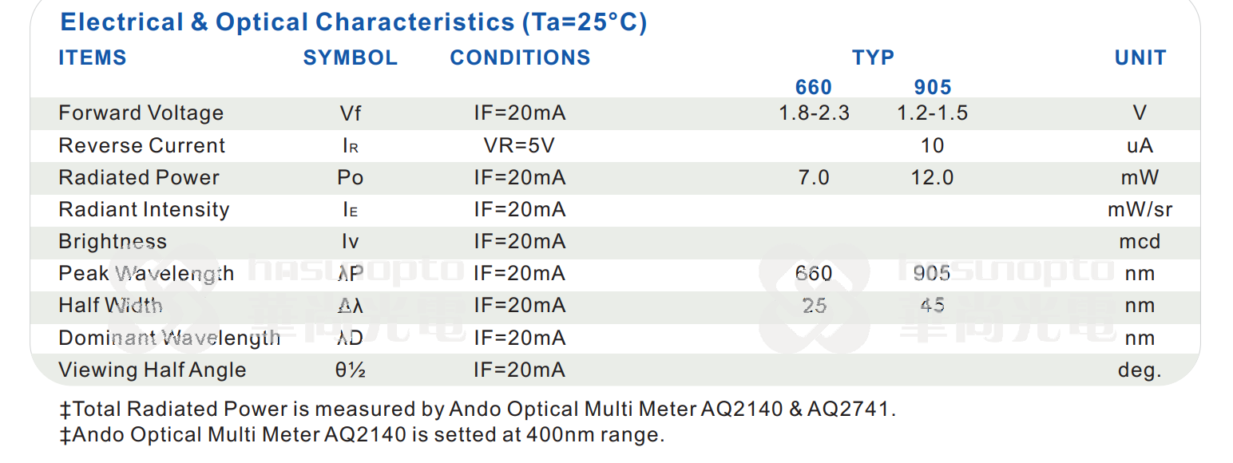
What To Do
PCB design is the focus
Notes:
Are there any records which can be destroyed without using the RDA?
Certain types of university records and information can be destroyed at any time without reference to this authority under what we call normal administrative practice or NAP. NAP covers the destruction of ephemeral material of a facilitative nature created, acquired or collected by university officers during the course of their duties.
The following material may be destroyed under NAP:
working papers consisting of rough notes and calculations used solely to assist in the preparation of other records such as correspondence, reports and statistical tabulations;
drafts not intended for retention as part of the office’s records, the content of which has been reproduced and incorporated in the university office's record keeping system;
extra copies of documents and published material preserved solely for reference (e.g. copies of minutes and agendas);
publications, superseded manuals, catalogues and trade journals held for informational purposes only;
unsolicited advertising material; and
copies.

Slide 24


© Copyright The University of Melbourne 2021

